Slide 1

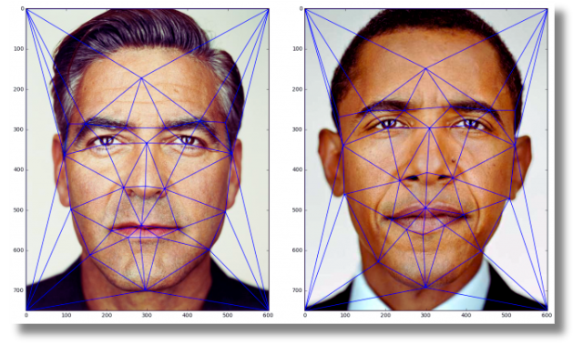
Morphed Face Image Detection System
Using PCA and Binary Classification
PCA Feature Extraction | SVM Classification | Biometric Security
R. SATHYAPRIYA (2025165002)
M.E CSE (DSCS)
DATASET: CIPLAB REAL & FAKE FACE DETECTION (KAGGLE) | 2,041 IMAGES

Slide 2
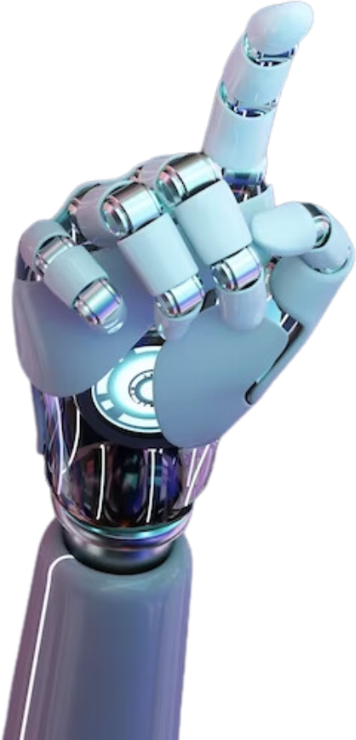
OBJECTIVE
Problem Statement:
Face morphing attacks combine two facial images to deceive biometric authentication systems. This project develops an ML-based system to automatically detect such morphed images.
Objectives:
Study face morphing attacks and their impact on biometric systems
Preprocess facial image datasets for machine learning processing
Extract important facial features using Principal Component Analysis (PCA)
Train and compare multiple ML classification models
Build a system to classify images as Original or Morphed
02

Slide 3
OVERALL ARCHITECTURE DIAGRAM
PCA
ExTRACTION
MODEL
TRAINING
ORIGINAL
Or
Morphed
KAGGLE DATASET
1,081 Original
960 Morphed
RESIZE 64X64
Grayscale
Normalize
150 COMPONENTS
95% VAriance
EIGENFaces
SVM / KNN
LOGIstic Reg
DECISIon Tree
IMAGE
CLASSIFY
DATA COLLECTION
IMAGE
PREPROCESS
03

Slide 4
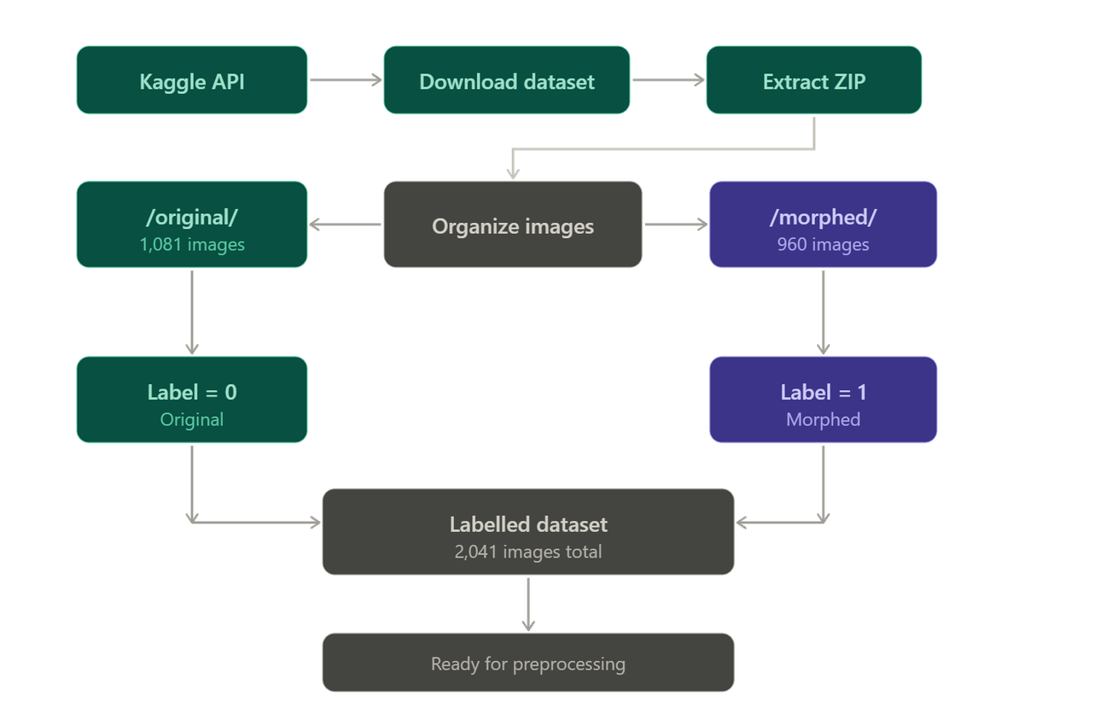
MODULE-WISE DESIGN DIAGRAM
MODULE 1 — DATA COLLECTION
04

Slide 5
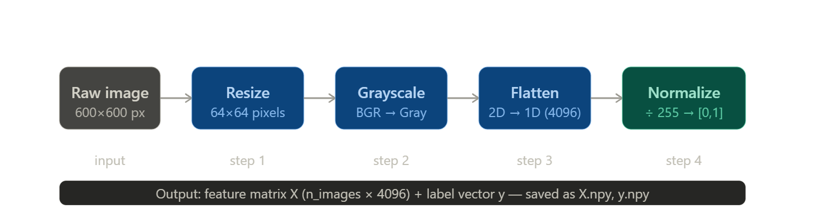
MODULE 2 — IMAGE PREPROCESSING
05

Slide 6
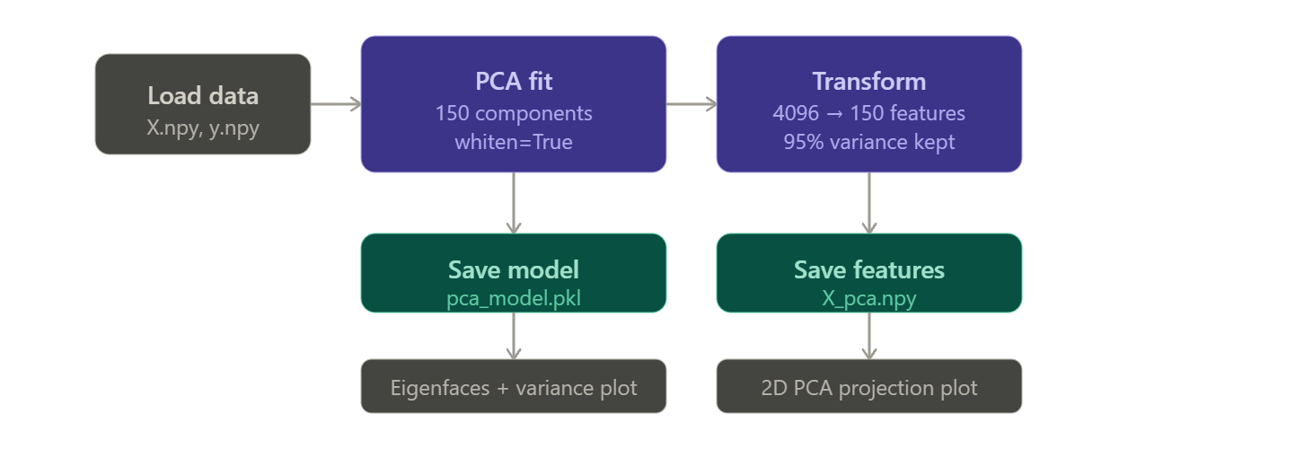
MODULE 3— PCA feature extraction
06

Slide 7
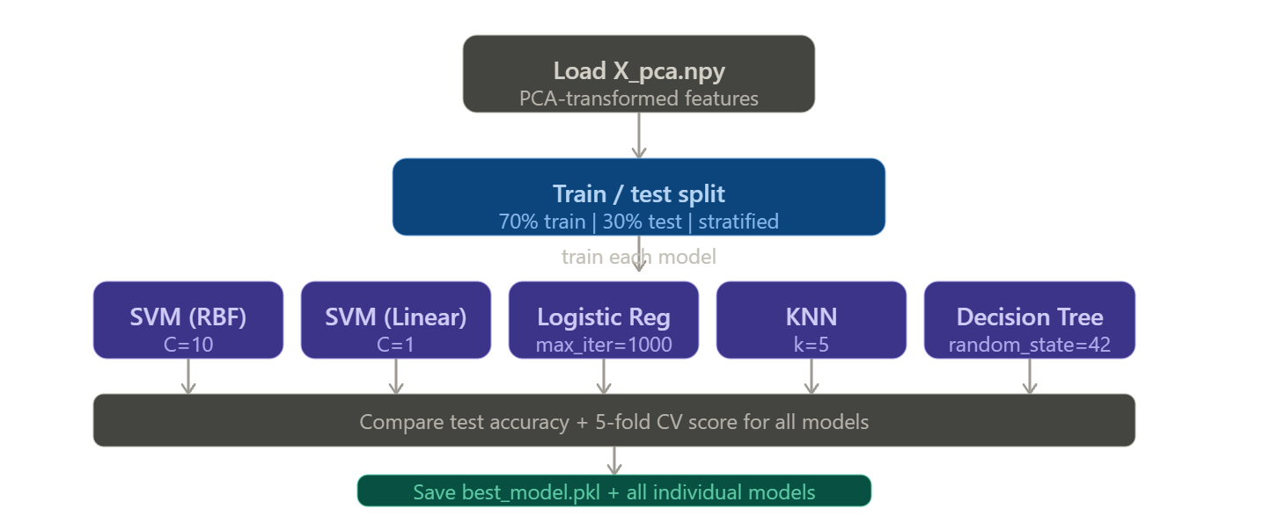
MODULE 4 — Model training
07

Slide 8
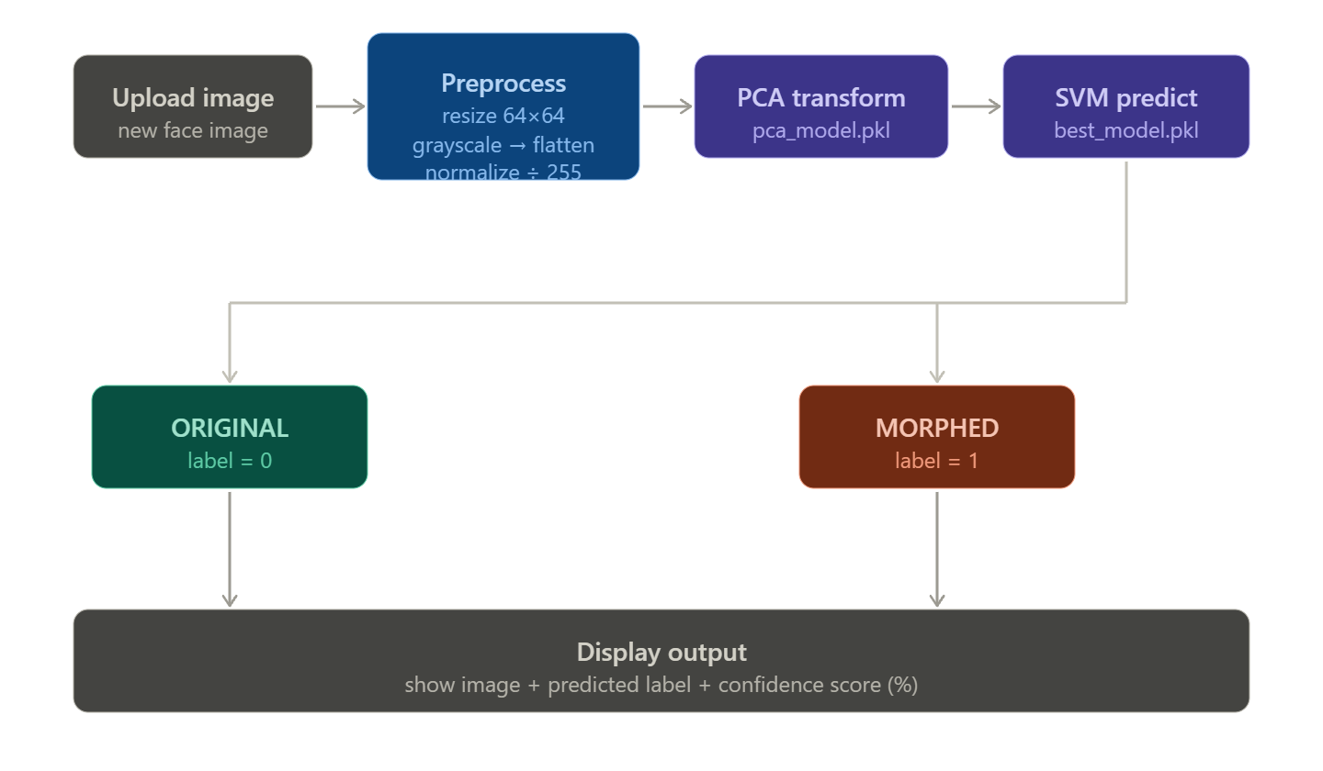
MODULE 5 — Image classification
08

Slide 9
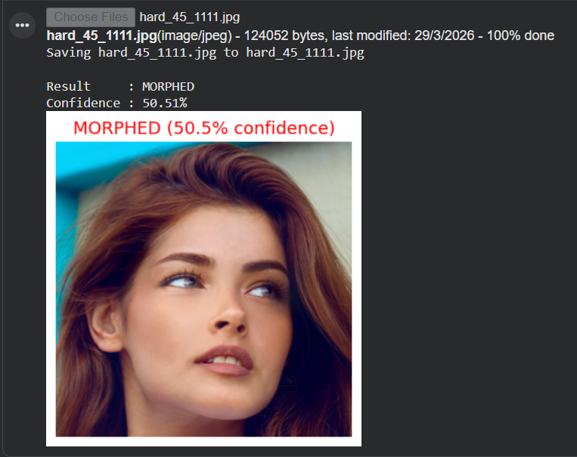
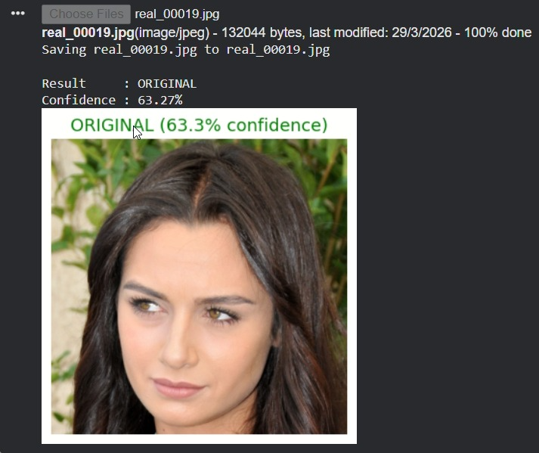
RESULTS & PERFORMANCE METRICS
09

Slide 10
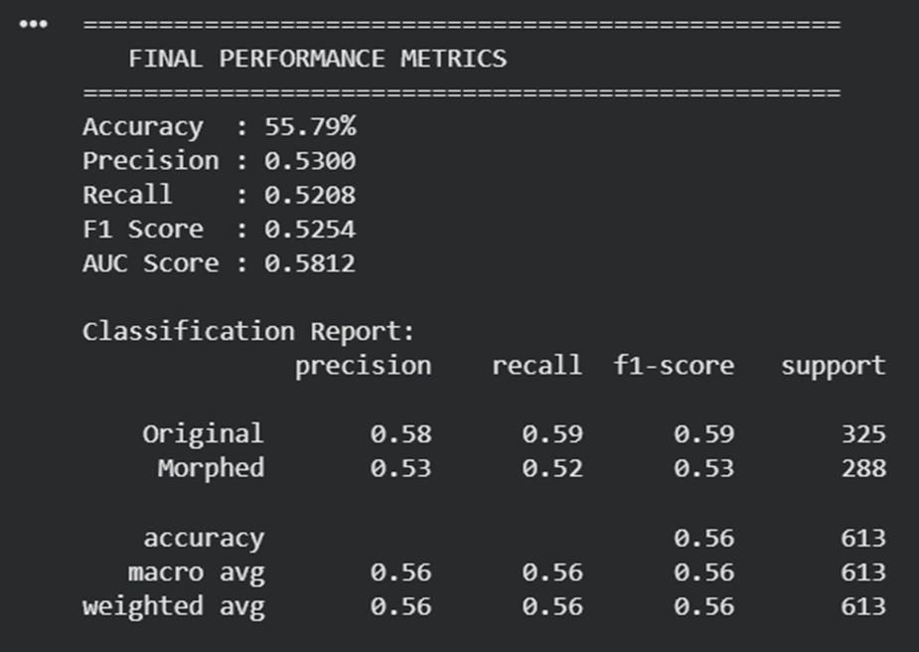
RESULTS & PERFORMANCE METRICS
10

